Slide 1
How Web Works? & Web Hosting
Unicom TIC
6th April 2024

Slide 2
Prerequisites
Understanding about Website and Web Applications.
Basic understanding about client and server.
Understanding the concept of Internet.

Slide 3
Learning Objectives
Understand the concept of Client Server Architecture
Understand the concept of DNS, HTTP, URL
Understand how web works
Type of Web Hosting

Slide 4
What is the World Wide Web (WWW)?
The World Wide Web, commonly known as the Web, is an interconnected system of documents and resources accessible via the Internet.
It enables users to access information, communicate, and interact with websites and web applications.
Notes:
The World Wide Web operates on the Internet, which is a global network of interconnected computers and devices. Through web browsers like Chrome, Firefox, Safari, and others, users can access websites hosted on servers anywhere in the world.

Slide 5
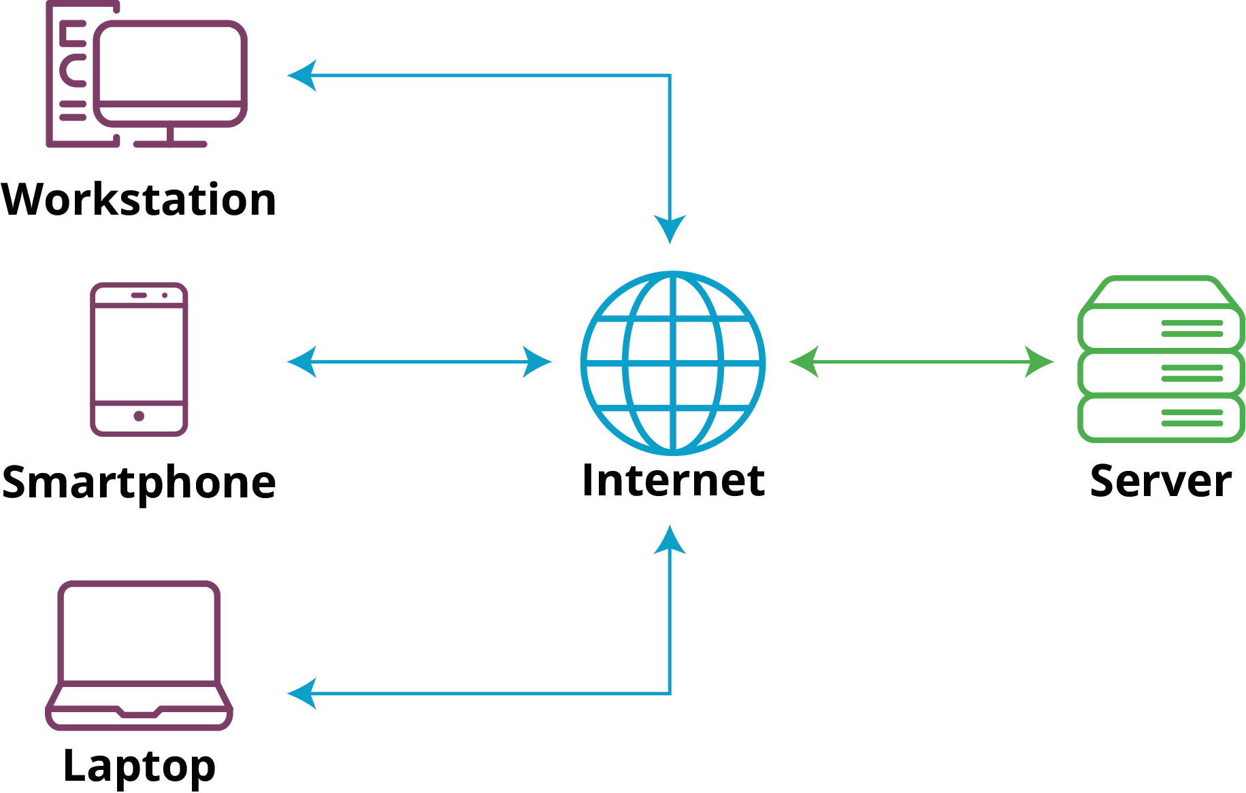
Client-Server Architecture
The Web operates on a client-server architecture.
Clients (such as web browsers) request resources from servers (computers that store and serve content).
Servers respond to client requests by providing the requested resources, such as web pages, images, or data.
Notes:
Client: A client is typically a web browser (like Chrome, Firefox, Safari) or a mobile app that requests resources or services from a server.
Server: A server is a remote computer or system that stores data, processes requests, and delivers resources or services to clients.

Slide 6
Domain Name System (DNS)
The Domain Name System translates domain names (e.g., www.example.com) into IP addresses.
DNS servers maintain a distributed database of domain names and their corresponding IP addresses, allowing users to access websites using human-readable addresses

Slide 7
Hypertext Transfer Protocol (HTTP)
HTTP is the protocol used for transferring hypertext documents (such as HTML files) on the Web.
It defines how clients and servers communicate, specifying rules for requesting and delivering web resources.
HTTPS (HTTP Secure) is a secure version of HTTP that encrypts data to ensure privacy and security.

Slide 8
Uniform Resource Locator (URL)
A URL is a string of characters that identifies a web resource's location on the Internet.
It consists of several components, including the protocol (e.g., http://), domain name, path, and optional query parameters.
URLs allow users to navigate the Web and access specific resources using web browsers.
https://domain.com/products/tshirt/men?color=black&brand=nike

Slide 9
Request-Response Cycle
When you enter a URL (Uniform Resource Locator) into your browser's address bar and press Enter, the following steps occur:
DNS Resolution: The browser sends a request to a DNS (Domain Name System) server to translate the domain name (e.g., www.example.com) into an IP address.
HTTP Request: The browser sends an HTTP (Hypertext Transfer Protocol) request to the server, specifying the resource (such as a webpage, image, or file) it wants to retrieve.
Server Processing: The server receives the request, processes it, and retrieves the requested resource from its storage (such as a file system or database).
HTTP Response: The server sends an HTTP response back to the client, containing the requested resource along with metadata like status codes, headers, and cookies.
Notes:
Web Browser: The process begins with the user interacting with a web browser, such as Chrome, Firefox, or Safari.
DNS Resolution: The browser sends a request to a DNS server to translate the domain name (e.g., www.example.com) into an IP address.
Web Server: The DNS server responds with the IP address of the web server hosting the requested website.
Server-side Processing: The web server receives the request and processes it. This involves tasks such as handling the request, accessing databases, executing application logic, and generating a response.
HTTP Response: The web server sends back an HTTP response to the browser. This response contains the requested resource/data (such as an HTML page, image, or file), along with metadata like status codes, headers, and cookies.
Web Browser (Client-side): The browser receives the response and renders the content on the user's screen. If the website uses client-side rendering (e.g., with JavaScript frameworks like React or Angular), the browser may execute JavaScript code to further manipulate the content.

Slide 10
Web Hosting
Web hosting is a service that allows individuals and organizations to make their websites accessible via the World Wide Web.
Web hosting providers offer the technologies and infrastructure needed to store and serve website files, making them accessible to users across the internet.

Slide 11
Types of Web Hosting
Shared Hosting: Multiple websites share resources (such as CPU, RAM, and disk space) on the same server. It's a cost-effective option suitable for small websites and blogs with moderate traffic.
Virtual Private Server (VPS) Hosting: A VPS hosting environment simulates a dedicated server within a shared server environment. Each VPS instance has its own dedicated resources and operating system, providing greater control and performance compared to shared hosting.

Slide 12
Types of Web Hosting
Dedicated Hosting: With dedicated hosting, an entire physical server is leased to a single customer. This offers maximum performance, customization, and control, making it suitable for large websites, e-commerce platforms, and applications with high traffic volumes.
Cloud Hosting: Cloud hosting utilizes a network of interconnected virtual servers to host websites. It offers scalability, reliability, and flexibility, allowing resources to be dynamically allocated based on demand. Cloud hosting is ideal for websites and applications that experience fluctuating traffic patterns.

Slide 13
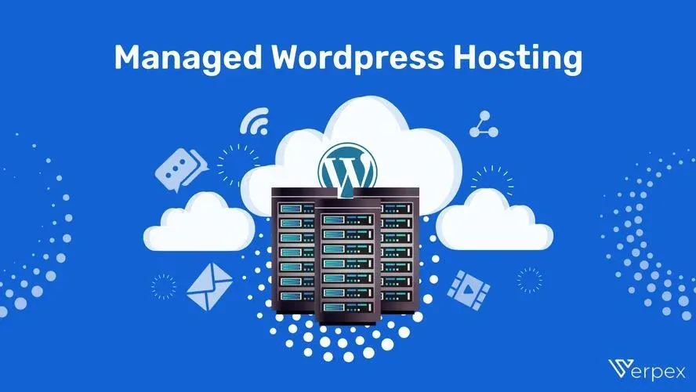
Types of Web Hosting
Managed WordPress Hosting: This type of hosting is optimized specifically for WordPress websites, offering features like automatic updates, enhanced security, and specialized support for WordPress-related issues.

Slide 14
Domain Name Management
In addition to hosting services, many providers offer domain name registration and management.
A domain name is the unique address that users type into their browsers to access a website (e.g., www.example.com).
Web hosting providers often offer domain registration as part of their service, allowing customers to register, renew, and manage domain names from a single interface

Slide 15
Control Panel and Management Tools
File Management: Uploading, downloading, and editing website files.
Database Management: Creating, modifying, and backing up databases (e.g., MySQL, PostgreSQL).
Email Management: Setting up email accounts, forwarding, autoresponders, and spam filters.
Security Settings: Configuring firewalls, SSL certificates, and access controls.

Slide 16
Technical Support
Web hosting providers offer technical support to assist customers with issues related to server configuration, website setup, troubleshooting, and maintenance.
Support may be provided via email, live chat, phone, or ticketing systems, depending on the provider.

Slide 17
Conclusion
Web hosting plays a crucial role in making websites accessible to users on the internet.
By leveraging the infrastructure and services provided by hosting providers, individuals and businesses can establish an online presence, share information, conduct e-commerce, and interact with their audience effectively.
Choosing the right web hosting plan and provider is essential for ensuring optimal performance, reliability, and security for your website.

